Slide 1
Software Engineering
CS3003
Lecture 4
Software Metrics
Yes what. But why

Slide 2
Structure of this lecture
This lecture will answer the questions:
What is the software measurement process?
What are entities, attributes and measures?
What are static and dynamic measurements?
What are direct and indirect measurements?
What is the Capability Maturity Model?

Slide 3
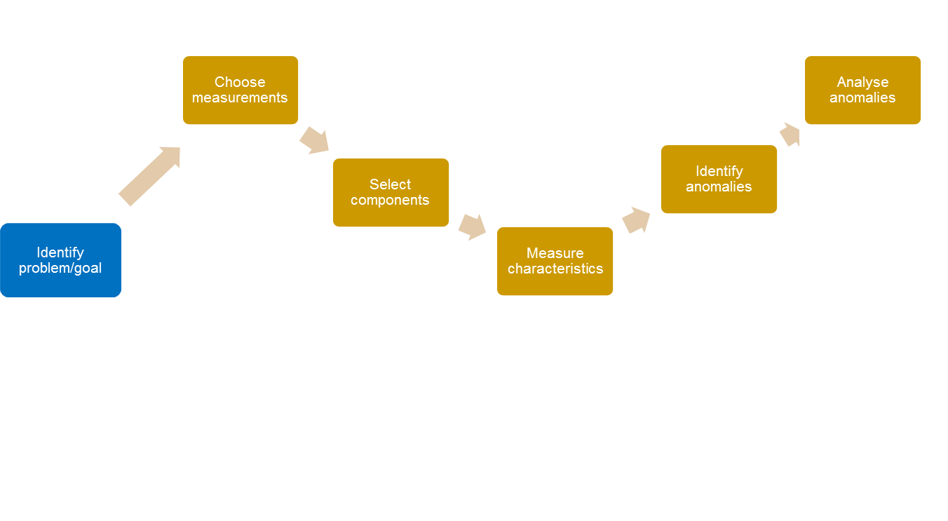
What is the software measurement process?
(Sommerville, ed 8, pg658)

Slide 4
The measurement process
1. Identify the problem/goal:
  Important to measure for a reason, e.g. which are the largest modules? Where is the code most complex? Who is most productive? Are code changes particularly fault prone?
  GQM (Goal/Question/Metric)
2. Choose measurements:
  Identifying what to measure in order to gather the data needed to answer the question is difficult, e.g. complexity measures?

Slide 5
Example: Complaints procedure - Home Office
Years of experience | Complaints dealt with | Time taken (avg, days) | DoC | Reopened
1 | 18 | 30 | 10 | 7
5 | 75 | 21 | 50 | 25
12 | 90 | 20 | 60 | 32
20 | 220 | 15 | 63 | 80

Slide 6
3. Select components:
  Often not possible to measure every part of the system. Need to select a rational sample.
4. Measure characteristics:
  Collect the data. Usually tools used, e.g. Eclipse
5. Identify anomalies:
  Store and compare values. Anomalous values identified.
6. Analyse anomalies:
  Look in detail at the reason for anomalies. Some may not indicate real problems.

Slide 7
How do we choose what to measure?

Slide 8
One approach: Goal Question Measure (GQM)
An approach to measurement within organisations
Start with goals
Each leads to questions
Finally, measures are defined for each question
    Source: Basili, Victor; Gianluigi Caldiera; H. Dieter Rombach, The goal question metric approach 1994.
    http://www.cs.umd.edu/~mvz/handouts/gqm.pdf

Slide 9
Goals
Something that the organisation is trying to achieve.
Example:
  reduce the number of faults introduced in development
  (could be also: minimise drop-outs in CS intake at BUL)

Slide 10
Questions
Specific aspects of the goal.
Examples:
  How faulty is current development?
  At what stages of development are faults introduced?
  Are there differences (between developers)?
  (could also be:
    what’s the background of intake?
    what’s their engagement like?)

Slide 11
Metrics
Measurements to be collected to answer the questions.
Examples:
  On average how many faults (per 1,000 LoC) are introduced in requirements?
  On average how many faults (per 1,000 LoC) are introduced in coding?
  For each developer, on average how many faults (per 1,000 LoC) do they introduce in coding?
  (but also: A-levels/Btec results? Attendance?)

Slide 12
How is measurement used?
Assessment of the current situation
  E.g. What proportion of tests failed?
Understand the process
  E.g. How effective is requirements capture?
Predict what will happen
  E.g. How much effort will be needed in maintenance
Learn from past history
  E.g. using Git reduces faults found in testing

Slide 13
Using measurements
Years of experience | Complaints dealt with | Time taken (avg, days) | DoC | Reopened
1 | 18 | 30 | 10 | 7
5 | 75 | 21 | 50 | 25
12 | 90 | 20 | 60 | 32
20 | 220 | 15 | 63 | 80

Slide 14
What are the basics of measuring software?
“Measurement is the process of empirical objective assignment of numbers to entities, in order to characterise a specific attribute”
Entity: Object or event
Attributes: Features or characteristics of entity
Measures: Assigned to attributes
Empirical: Based on real world observation
Objective: Repeatable
Data: Numbers collected quantifying a measure

Slide 15
Examples….
Entity Attribute Measures
Code Length #LOC, #pages
Quality Fault density
Testing Duration Days from start to finish
Effectiveness #Faults found per day
Coder Efficiency KLOC/hour

Slide 16
What is important about entities?
Resources
Processes
Products
Process: a software related activity or event
Product: an object which results from a process
Resource: an item which is input to a process

Slide 17
What is important about attributes?
Internal attributes:
  Can be measured only in terms of the entity
  E.g. length or complexity of code
External attributes:
  Affected by how the entity relates to its environment
  E.g. reliability or maintainability

Slide 18
What is important about measures?
Direct measures
  Measures that can have numbers directly attributed to them
  Examples include:
    Length of source code (measured in LOC)
    Effort of programmers on a project
Indirect measures
  Measures that cannot have numbers directly attributed and need surrogate measures
  Examples include:
    Programmer productivity
    Module fault density
    Requirements stability

Slide 19
What are static and dynamic measurements?
Dynamic measures:
  Data collected during the execution of the system
  Map to system quality characteristics
  E.g. reliability, usability, efficiency
Static measures:
  Data not collected during system execution
  Data based on static products, e.g. code, designs
  Have an indirect mapping to system quality attributes.
  E.g. complexity, size, understandability
  Most development tools automatically calculate many static code measures

Slide 20
Capability Maturity Model (CMM)
Process improvement
Different levels of ‘maturity’ for organisations/groups – 1 to 5 (5 is most mature).
Higher levels use measurement for process assessment and improvement
Sponsored by US Department of Defense
Extended to CMM Integration (CMMI)

Slide 21
CMM levels
Level 1: Initial
Level 2: Repeatable
Level 3: Defined
Level 4: Managed
Level 5: Optimising
CMU/SEI-93-TR-024 (technical report). URL: http://www.sei.cmu.edu/reports/93tr024.pdf

Slide 22
Level 1: Initial
The software process is characterised as ad hoc, and occasionally even chaotic. Few processes are defined, and success depends on individual effort.
Bus Factor: HIGH

Slide 23
Level 2: Repeatable
Basic project management processes are established to track cost, schedule, and functionality. The necessary process discipline is in place to repeat earlier successes on projects with similar applications.
Bus Factor: MEDIUM

Slide 24
Level 3: Defined
The software process for both management and engineering activities is documented, standardised, and integrated into a standard software process for the organisation. All projects use an approved, tailored version of the organisation's standard software process for developing and maintaining software.

Slide 25
Level 4: Managed
Detailed measures of the software process and product quality are collected. Both the software process and products are quantitatively understood and controlled.

Slide 26
Level 5: Optimising
Continuous process improvement is enabled by quantitative feedback from the process and from piloting innovative ideas and technologies.

Slide 27
Reading for the week
Find out more about the Goal/Question/Metric (GQM) model.
Learn how to apply the Function Point approach to measuring software size. Fenton & Pfleeger ‘Software Metrics’, 1996 has an excellent section of FPs. Alternatively this is also a good place to start: http://www.gantthead.com/process/popup.cfm?ID=15626

